Slide 1



Region 7
AVATAR
Looking at Region 7’s College Readiness Data
and
Our Purpose

Slide 2
Academic Vertical Alignment Training and Renewal
AVATAR
Development
Explanation
AVATAR is a Texas Higher Education Coordinating Board (THECB) project which is implemented by the North Texas Regional P-16 Council and the University of North Texas.
AVATAR is a statewide network, comprised of regional efforts, focused on vertical alignment to support students’ college and career readiness and success.

Slide 3
Purpose:
Facilitate the development of a math college preparatory course in compliance with House Bill 5, 83rd Legislature, Regular Session, 2013.
  Requires that the courses be designed for grade 12 students whose performance on an EOC exam does not meet college readiness standards; or coursework, college entrance exam, or higher education screener indicates the student is not ready for college-ready coursework.

Slide 4
Our Charge
What do we need to provide students in order to be successful in their freshman level math course?
Focus on students who either did not or could not pass the Texas Success Initiative (TSI) exam.
Create a forum for discussion of logistical and practical implementation strategies such as dual credit, grading, documenting on transcripts.

Slide 5
Region 7 Performance Index Report:
2013 Compared to 2014
Index 1: Student Achievement, Index 2: Student Progress,
Index 3: Closing Performance Gaps, and Index 4: Postsecondary Readiness

Slide 6
Region 7
2014 Index 3 Closing Performance Gaps
Index 3: Index 3 data indicates greater gains in the performance of mathematics and reading for the Hispanic and Economically Disadvantaged (ECD) student groups. Analysis indicates a continued challenge with closing the performance gap in mathematics and reading for the African American student group. When comparing Region 7 data to the state, the African American student group regional data (mathematics: 58% and Reading: 62%) was below the state average (mathematics: 62% and Reading: 67%).

Slide 7
2014 Region 7 LEP STAAR Results Compared to State
Region 7 LEP student subgroup performed 3-8% lower than the state in Algebra I and English I; however, Region 7 LEP students performed 3% higher than the state in English II.

Slide 8
Region 7 2014
Index 4 Post Secondary Readiness
Chart data is derived from the State and Region 7 Accountability Summaries: Postsecondary Readiness Data Table.
Region 7 exceeded the Federal Graduation Rate target of 80% in all student groups, except for the ELL group (75.30%). Additionally, the all student groups, except for the American Indian group, which led Region 7’s group by less than one percentage point, exceeded the state rates.
Federal Graduation Rates:
Graduation Rate Goal of 90%
4-Year Graduation Rate Target of 80%

Slide 9
Region 7 2014
Index 4 Post Secondary Readiness
There was an increase in the percentage of students graduating on the RHSP/DAP plans over the previous year. The largest gain was in the African-American group, which gained 4 percentage points. There were no rates posted for the Special Education, Economically Disadvantaged, or English Language Learner groups on the most recent TAPR.

Slide 10
Region 7 2014
Index 4 Post Secondary Readiness
No new data has been released at this time for SAT results.

Slide 11
Region 7 2014
Index 4 Post Secondary Readiness
[No NEW Data] This chart shows the percentage of examinees with at least one AP or IB score at or above the criterion score (3 on AP or 4 on IB). The data for English language learner (ELL) and Special Education (SE) was NA for 2010-2012. Economically disadvantaged (ECD) data was only available for 2012.

Slide 12
Region 7 2014
Index 4 Post Secondary Readiness
The Region 7 students lagged behind the state in all areas, except for the American Indian group, which performed 4 percentage points better. The widest gap was seen with the Two or More races’ group, which performed 18 percentage points lower than the state average. There were no Region 7 outcomes posted for special education, English language learners, or Pacific Islanders.

Slide 13
Region 7 2014
Index 4 Post Secondary Readiness
NO NEW DATA] In the area of Math, districts in Region 7 have variable achievement across the three years of data.

Slide 14
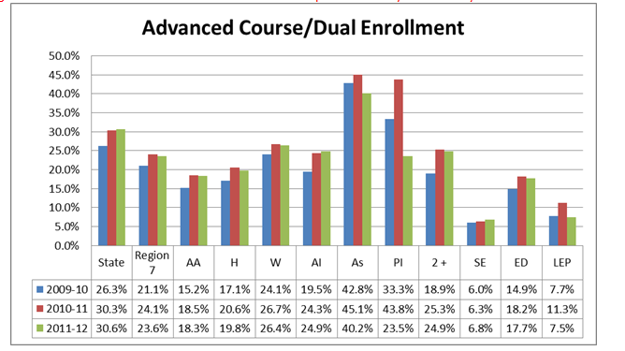
Region 7 2014
Index 4 Post Secondary Readiness
No new data has been released at this time for advanced course and dual enrollment results.

Slide 16
Resources
AVATAR
  http://www.ntp16.notlb.com/avatar
Texas Academic Performance Report
  http://ritter.tea.state.tx.us/perfreport/account/2014/index.html
Texas Higher Education Coordinating Board
  http://www.thecb.state.tx.us/

