Slide 1

The University of Texas Rio Grande Valley
P-16 Outreach
Barbara Jean Garza
Director of P-16 Outreach
Barbara.garza@utrgv.edu
956-665-7597

Slide 2

Mission
The Office of P-16 Outreach, under the Division of Student Success, and Educational Outreach at UTRGV provides outreach services in support of Closing the Gaps, Generation Texas, and the 60x30TX state initiatives. (State Recognized movements)
Efforts are clustered around the following principal services:
The Mother-Daughter Program
Go Centers/Collegiate G-Force Mentorship Program
Generation Texas Movement
Migrant Outreach Services
Summer Enrichment Programs and Conferences
P-16 Council Presence and other Statewide Partnerships

Slide 3
60x30TX

Slide 4
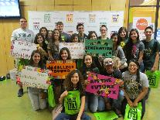
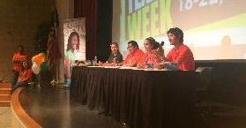
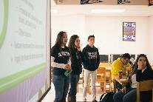
Collegiate Mentorship Program
Funded by THECB
  UTRGV awarded 2nd highest award across the state!
  Funding awards college students at UTRGV the opportunity to serve as mentors in valley high schools and support their peers through college transition

Slide 5

Generation Texas
Generation Texas (GenTX)
One of the goals of Generation Texas is to promote a college going culture and help high school students, especially first-generation students, navigate their way to and through higher education. When GenTX students graduate from higher education, they will contribute to the 60x30 Goal and to the Completion Goal. The Generation Texas initiative will continue through the new plan, and remain a portal for college-going information, advice, and resources. GenTX has several key initiatives planned for 2015 – 2016. The events include GenTX College Application Week, GenTX FAFSA Workshops, and GenTX Decision Day.
GenTX Day Participation 2015 included the following:
29,913 Admission Applications submitted, including 10,000+ Seniors
25,000 K-12 Students involved in College and Career Readiness Activities
33,159 Facebook impressions
8,767 GenTX Twitter impressions
Important Dates:
GenTX College Application Week (November 16-21, 2015)
Generation Texas (GenTX) FAFSA Workshops (February 1-28, 2016)
Generation Texas (GenTX) Decision Day (May 6, 2016)

Slide 6

The University of Texas Rio Grande Valley
College Prep Courses
College of Education and P-16 Integration
Shirley J. Mills
Shirley.mills@utrgv.edu
956-665-7427

Slide 7
REGION I AND REGION II MOA
Texas A&M International University
Coastal Bend College
Del Mar College
Texas A&M University Corpus Christi
Texas A&M University Kingsville
University of Texas Rio Grande Valley
South Texas College
Texas Southmost College
Texas State Technical College
Laredo Community College

Slide 8
College Prep Courses (CPC)
Not a test prep
College readiness courses
Math assignments are online but requires teacher support during class time
ELA has an online book; requires full time teacher

Slide 9
Successful Course Completion
Both courses require a 70% for the final course grade
Math final exam requires 70% or higher
ELA requires 70% for Final Portfolio
Is effective for TWO years for student

Slide 10
Who should take these college prep course(s)?
“Bubble” students who want to go to college and have passed their End of Course (EOC) exams in reading, writing, and/or math
Not yet college ready in Math, Reading or Writing

Slide 11
Possible Issues
Start Time for ELA and Math beginning of the semester
Need full year of work to be college ready
Mandatory Trainings

Slide 12
The University of Texas Rio Grande Valley
THANK YOU!

