Slide 1
Creating Curriculum for Multi-Institutional Health Career Pathways through Partnership NISOD 2016 International Conference,
May 30, 2016; Austin, TX

Slide 2
Meet the Presenters
Jean Keller will introduce the AVATAR project.
Kathy Wright-Chapman will introduce an application facilitated by Texas Regional Education Service Center 11 for a partnership of school districts, community colleges, and universities.
Michael Endy will explain the central role of Weatherford College in planning and development of the health career academies partnership.
Mary Harris will lead reflection on lessons to be learned from application of the AVATAR model in a multi-institutional, career-focused context.
http://untavatar.org

Slide 3

What is AVATAR?
Name (include yourself) | District/University/Workforce or P-16 Council | Title/Position |  | Phone
LaShonda Evans | Region 4 ESC | Education Specialist | lashonda.evans@esc4.net | 713-744-6380
June Giddings | GCPASS/Houston A+ Challenge | Director | jgiddings@houstonaplus.org | 713-658-1881
Cynthia Williams | Spring ISD | CTE Director | cynthiaw@springisd.org | 281-891-6200
Tiffany Rhodriquez | Spring ISD | Guidance & Counseling Director | trhodri@springisd.org | 281-891-6368
Beth Gilleland | Klein ISD | Student Support Services Officer | egilleland@kleinisd.net | 832-249-4319
Michelle McCharen | Klein ISD | College & Career Readiness Counselor | mmcharen@kleinisd.net | 281-467-3192
Brian Reeves | Lone Star University Park | English Department Chair | Brian.L.Reeves@lonestar.edu | 281-290-3749
Martha Donnelly | Lone Star University Park | Math Department Chair | Martha.E.Donnelly@lonestar.edu | 281-290-5053

Slide 4
Basic Facts: AVATAR
Academic Vertical Alignment Training and Renewal
First funded in 2011 by the Texas Higher Education Coordinating Board as part of its Closing the Gaps strategic plan
Facilitated by the University of North Texas for the North Texas Regional P-16 Council, which serves the Dallas Fort Worth and Metroplex areas
Active in 2015 in all 20 Education Service Center regions of the Texas Education Agency
http://untavatar.org

Slide 5
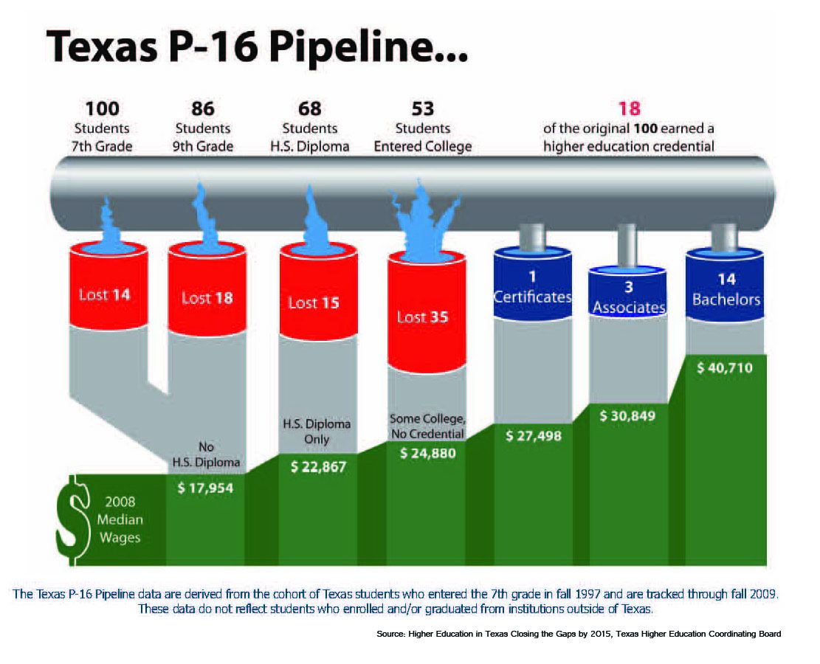

Slide 6
High Schools
2 Year IHEs
Scaffolding
Student
Success
4 Year IHEs
Regional ESCs
Regional P-16
Councils
AVATAR is a Partnership of Regional Leaders from these institutions

Slide 7
AVATAR enables Critical Conversations
Secondary
Post-Secondary
Graduate College/Career Ready
Graduate Career Ready
Impact of Developmental Education and
Texas Success Initiative
Dual Credit, Early College High Schools
Student Support Services
Educational Policies & Practices
Classroom Instruction, Textbooks
Grading, etc.
Discipline Reference Course
Profiles
College & Career Readiness
Standards
Student Success Assessments
Dual Credit, Early College High Schools
Student Support Services
Educational Policies & Practices
Classroom Instruction, Textbooks
Grading, etc.
Discipline Specific Course Curriculum
Texas Essential Knowledge and Skills

Slide 8
Changing Focus of AVATAR
Close gaps in student access to and success in post-secondary education through collaboration focused on
2011-14: Vertical alignment of the core curriculum
2014-15: Vertical alignment through College Preparatory Courses in ELA and mathematics designed for high school students who are not college ready and may, according to local agreement, exempt the TSI (a provision of HB 5, 2013)
2015-16: Vertical alignment of curriculum arising from endorsement options offered by local high schools and continuation of work begun in earlier years (a provision of HB 5, 2013)
http://untavatar.org

Slide 9
High School Graduation Endorsement Options Enabled by HB 5 (TX Leg. 2013)
Endorsements
STEM (Science, Technology, Engineering, and Mathematics)
Business and Industry
Public Services
Arts and Humanities
Multidisciplinary Studies
Notes:
Notes:
HB 5 requires that the endorsement will be placed on the diploma and transcript.
SBOE can choose to include specific course requirements in each of the endorsement areas but we do not know yet if they will do this. They have the authority to do so.
HB 5 requires that students must have multiple options for earning each endorsement, including, to the greatest extent possible, coherent sequences of courses. Additionally, the statute requires that student must be permitted to enroll in courses under more than one endorsement curriculum before the student’s junior year.
STEM – least complicated endorsement in statute. TEA has talked with SBOE about possible CTE courses for this area.
Business and Industry – aligns a lot to the current career clusters in CTE. TEA has visited with SBOE about possibly aligning these to the current coherent sequences in clusters.
Public Services – Per TEA’s conversation with SBOE, Culinary Arts & Hospitality may be moved from this endorsement to the Business and Industry endorsement.
Arts and Humanities – Per TEA’s conversation with SBOE, Political Science may be moving to Public Services – as that is more closely aligned with where courses reside within current course clusters.

Slide 10

How did Region 11 Facilitate the Work?

Slide 11
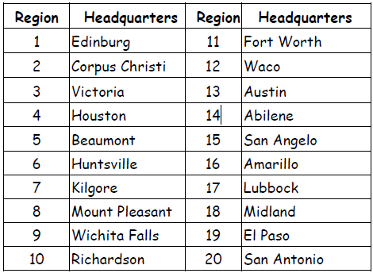
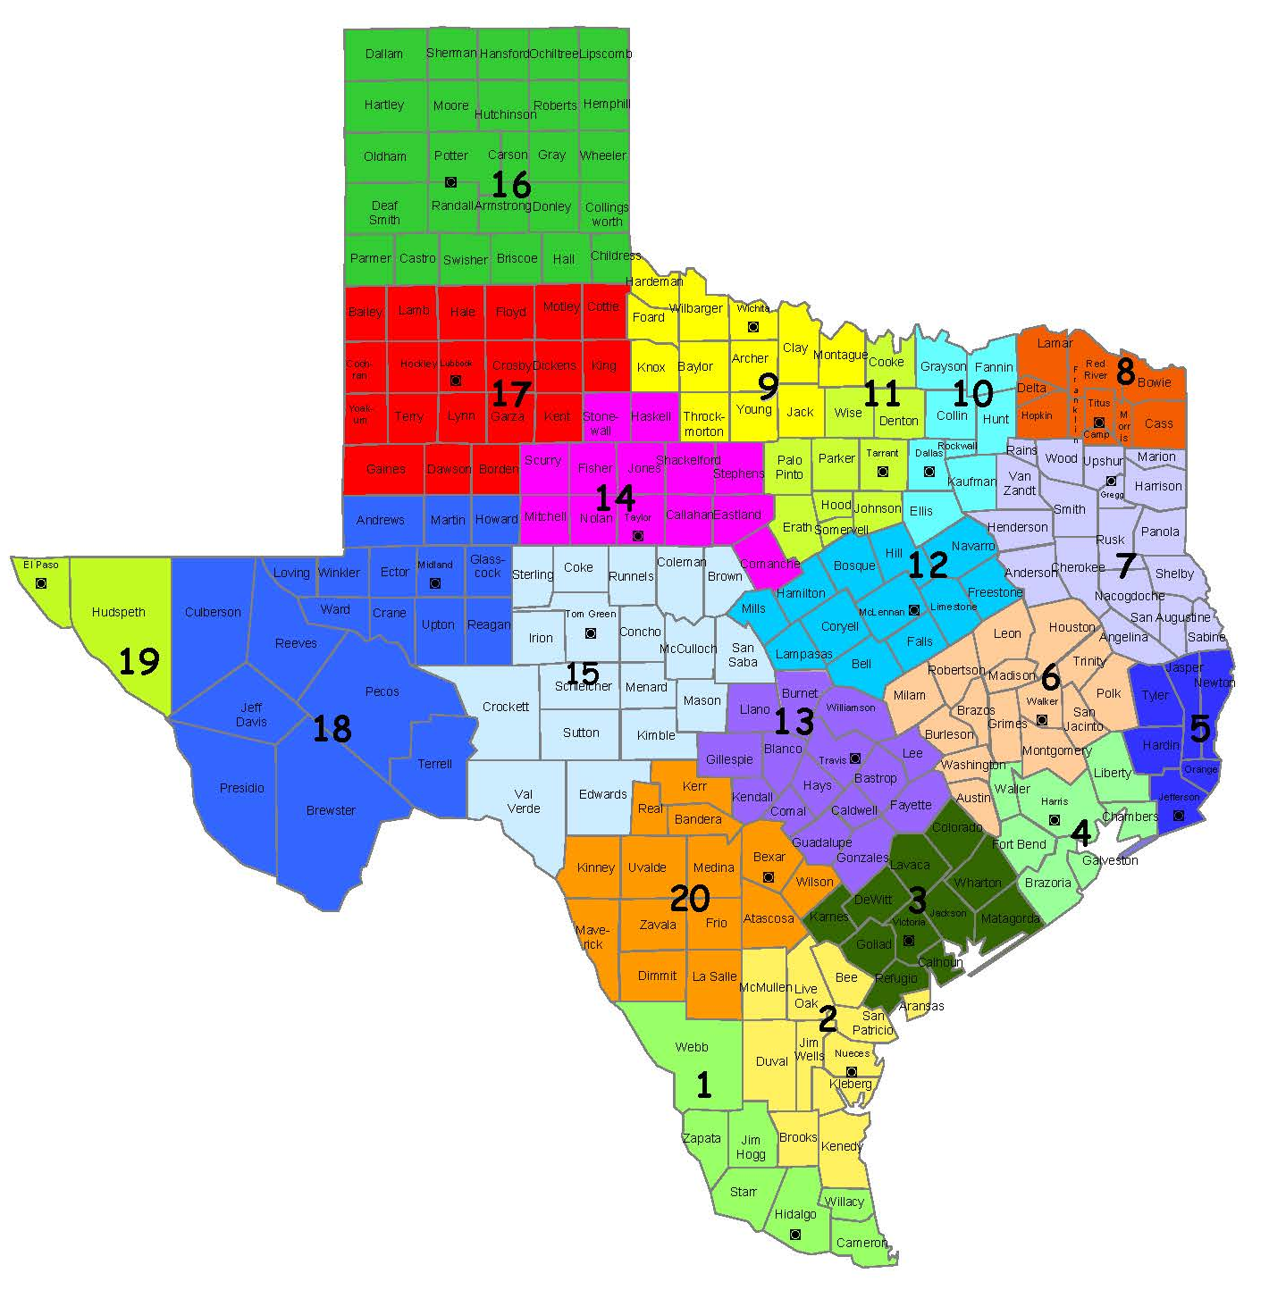
Texas Regional
Education Service Centers (ESC)

Slide 12
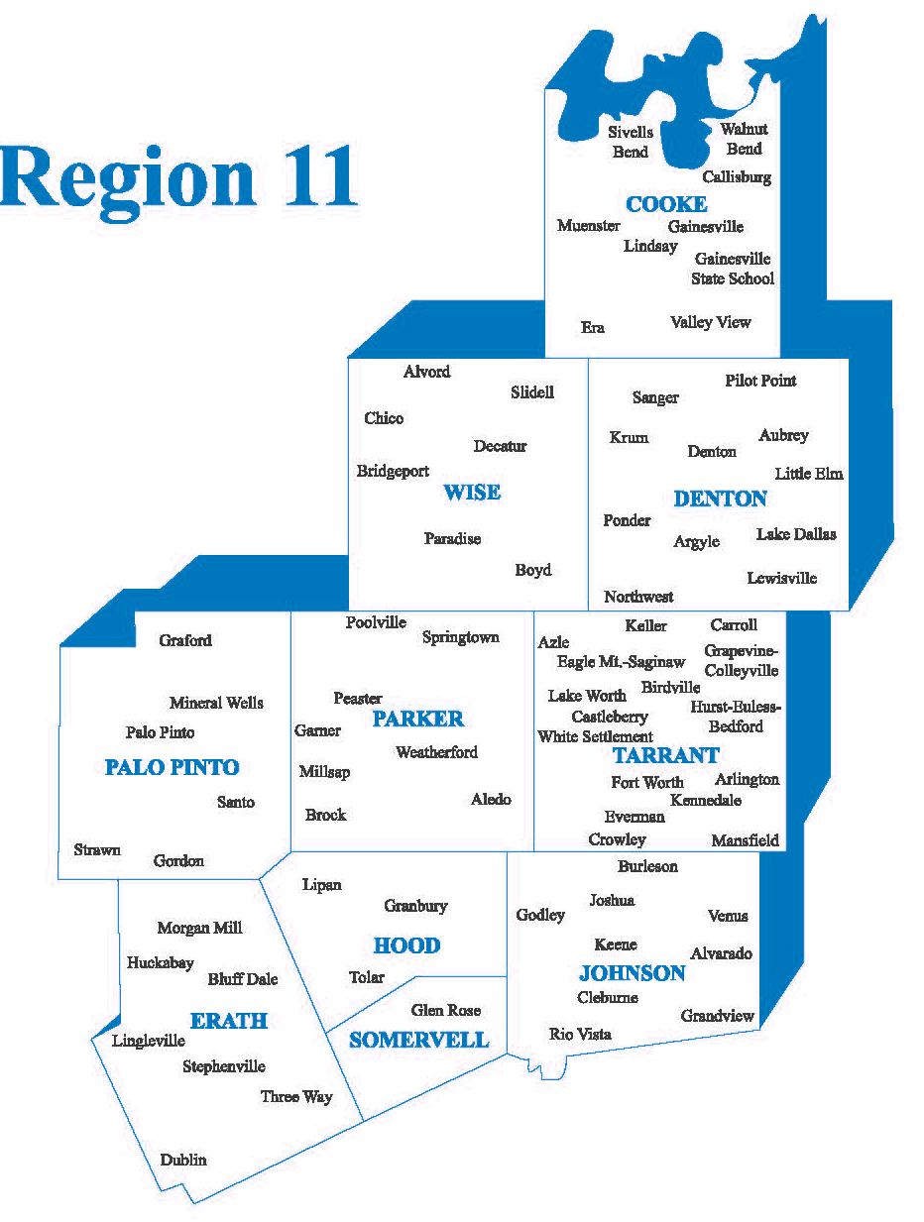
ESC Region 11 serves:
Counties: 10
Public School Districts: 77
Charter Schools: 62
Private Schools: 106
Educators: 69,310
Students: 569,487

Slide 13
ESC Region 11 AVATAR Project
Project focus emerged from an identified need of rural districts that struggle with
IHE dual credit access,
certification course access,
certified personnel,
course resources,
and lack of funding for implementation of a more differentiated high school curriculum.

Slide 14
Brock, Gordon, Lipan, Millsap, Mineral Wells, Perrin-White High Schools
Ranger College; Weatherford College
Tarleton State University; UNT
Scaffolding
Student
Success
Workforce Solutions for North Central Texas
Regional 11 ESCs
Th Health Careers Pathway Partnership in Region 11 included these institutions

Slide 15
ESC Region 11 AVATAR Project Focus
Develop a Health Science Academy partnership comprised of rural districts, Two-Year IHEs, Four-Year IHEs, and Workforce/Industry leadership
Design a Health Science Academy focused on an articulated set of high school courses supporting high school graduation endorsements, professional certifications, Two-Year IHE associate degree and/or Four-Year IHE degree
Create a Health Science Academy course curriculum vertically aligned to the TEKS and College and Career Readiness Standards
Provide Health Science Academy Initial courses in multiple formats (face-to-face and/or distance learning) beginning Fall 2016
Design and implement a sustainability plan

Slide 16
THECB AVATAR Funding
THECB AVATAR Project Total Funding - $8,500
  District staff travel and meeting - $6,420.00
  IHE staff stipend for meeting attendance - $1,680.00 ($50.00 per meeting)
  ESC Region 11 staff meeting travel and printing - $400.00

Slide 17
ESC Region 11 AVATAR Project Overview
Three Hour Partnership Meetings
  May 12, 2015 (AVATAR Project overview to selected 6 rural districts)
  June 25, 2015 (District partnership created and project focus discussed)
  September 21, 2015 ( 2 Two-Year and 2 Four-Year IHE Partners joined the project)
  November 18, 2015 (Two-Year IHE partner took the lead in developing course scope and sequence)
  December 17, 2015 (District and IHE key staff created a sub-committee to identify Academy specific courses)

Slide 18
ESC Region 11 AVATAR Project Overview
Three Hour Partnership Meetings
  January 21, 2016: Report of sub-committee recommendations, and North Central Texas Workforce staff joined the meeting.
  February 21, 2016: District and IHE sub-committee met to fine tune Academy focus by identifying IHE courses, qualified teaching staff, certifications/licenses, resources, and creating an overall Academy plan to present to district school board, students, and families.
  April 7, 2016: District and IHE sub-committee report and identify implementation next steps.
  June 6. 2016: Discuss what is working and not working and schedule 2016-2017 partnership meetings
  .

Slide 19

What role was played by Weatherford College?

Slide 20

Weatherford College
Facts
Service Area: Hood, Parker, Palo Pinto, Wise (Region 11) and Jack (Region 9) Counties
25 public; 9 other secondary education partners
5500 semester enrollment
20% dual credit enrollment
450 health science slots

Slide 21
AVATAR Health Science
Partner Desirables
IHE Challenges
Embedded Programs
  Nursing
  Pre-med
Guaranteed Entry
Immediate Access
Reduced Cost
Remote, Multisite Delivery
Licensure Requirements
Program Costs
  Facilities
  Equipment
  Staffing
Clinical Sites

Slide 22
AVATAR Health Science
Options
Adoptions
Prep Programs
  Nursing
  Pre-med
Related Health Fields
  Human Services Provider
  Emergency Services
VN or Phlebotomy
College Academies Decatur, Weatherford, Rural Alliance
Ongoing Development of VN Pilot Program
2 Districts to Ranger

Slide 23
What Can We Learn from this Multi-institutional, Career-focused Curriculum Example?
Name (include yourself) | District/University/Workforce or P-16 Council | Title/Position |  | Phone
LaShonda Evans | Region 4 ESC | Education Specialist | lashonda.evans@esc4.net | 713-744-6380
June Giddings | GCPASS/Houston A+ Challenge | Director | jgiddings@houstonaplus.org | 713-658-1881
Cynthia Williams | Spring ISD | CTE Director | cynthiaw@springisd.org | 281-891-6200
Tiffany Rhodriquez | Spring ISD | Guidance & Counseling Director | trhodri@springisd.org | 281-891-6368
Beth Gilleland | Klein ISD | Student Support Services Officer | egilleland@kleinisd.net | 832-249-4319
Michelle McCharen | Klein ISD | College & Career Readiness Counselor | mmcharen@kleinisd.net | 281-467-3192
Brian Reeves | Lone Star University Park | English Department Chair | Brian.L.Reeves@lonestar.edu | 281-290-3749
Martha Donnelly | Lone Star University Park | Math Department Chair | Martha.E.Donnelly@lonestar.edu | 281-290-5053

Slide 24

Why was it successful?
http://untavatar.org

Slide 25
Why was it successful?
The vision of a health career pathway was shared among the partners.
The right education partners were at the table.
Institutional leaders were involved, active, and able to call others to the table.
Meetings were well and dependably facilitated.
People did their homework on time.
Group members were open in sharing problems and challenges.
Higher education members collaborated.
http://untavatar.org

Slide 26
What could have been done differently?
http://untavatar.org

Slide 27
What could have been done differently?
Business partners could have been active in the curriculum planning.
Plans could have been made for sustainability through an MOU that provided for 1) development and vertical alignment of curriculum, 2) on-going administrative oversight, and 3) evaluation.
Plans might have been made for multi-institutional professional development of faculty.
Short-term funding may be available through Workforce Solutions.
http://untavatar.org

Slide 28
Final thoughts?
http://untavatar.org

Slide 29
Contact the Presenters
Jean Keller, Professor, Kinesiology, Health Promotion,and Recreation, UNT, Denton, TX, 940 565-3427, jean.keller@unt.edu
Kathy Wright-Chapman, Director, Research and Evaluation, Region 11 Education Service Center, Fort Worth, TX, 817 740-7546, kwc@esc11.net
Michael Endy, Executive Dean of Academics, Weatherford College, Weatherford, TX, 817 598-6211, mendy@wc.edu
Mary Harris, Professor Emeritus, Teacher Education and Administration, UNT, Denton, TX, 940 367-3026, mary.harris@unt.edu
http://untavatar.org

