Slide 1
The Time Is Now for Family and Community Engagement
CSOTTE Teacher Education Conference
October 27, 2015
Frisco, Texas

Slide 2
What is AVATAR?
Academic Vertical Alignment Training and Renewal
First funded in 2011 by the Texas Higher Education Coordinating Board as part of its Closing the Gaps strategic plan
Facilitated by the University of North Texas for the North Texas Regional P-16 Council, which serves the Dallas Fort Worth area
Currently active in all 20 Education Service Center regions of the Texas Education Agency
http://untavatar.org

Slide 3
High Schools
2 Year IHEs
Scaffolding
Student
Success
4 Year IHEs
Regional ESCs
Regional P-16
Councils
AVATAR is a Partnership of Regional Leaders from these institutions

Slide 4
The AVATAR Process
Creates and builds relationships through ongoing critical conversations among partnership members
Uses regional data to make alignment decisions
Develops shared understanding of college and career readiness and success for students
Identifies and implements intentional actions
Evaluates, sustains, and shares vertical alignment work with professional and lay communities
http://untavatar.org

Slide 5
Presentation Overview
National and state trends compel attention to family engagement
Status of family engagement within teacher education
Actions to prepare teachers to engage families now!
http://untavatar.org

Slide 6

National Imperatives for Family Engagement
Name (include yourself) | District/University/Workforce or P-16 Council | Title/Position |  | Phone
LaShonda Evans | Region 4 ESC | Education Specialist | lashonda.evans@esc4.net | 713-744-6380
June Giddings | GCPASS/Houston A+ Challenge | Director | jgiddings@houstonaplus.org | 713-658-1881
Cynthia Williams | Spring ISD | CTE Director | cynthiaw@springisd.org | 281-891-6200
Tiffany Rhodriquez | Spring ISD | Guidance & Counseling Director | trhodri@springisd.org | 281-891-6368
Beth Gilleland | Klein ISD | Student Support Services Officer | egilleland@kleinisd.net | 832-249-4319
Michelle McCharen | Klein ISD | College & Career Readiness Counselor | mmcharen@kleinisd.net | 281-467-3192
Brian Reeves | Lone Star University Park | English Department Chair | Brian.L.Reeves@lonestar.edu | 281-290-3749
Martha Donnelly | Lone Star University Park | Math Department Chair | Martha.E.Donnelly@lonestar.edu | 281-290-5053

Slide 7

Clear and Consistent Research
The evidence is now beyond dispute. When parents are involved in their children’s education at home their children do better in school.

Slide 8

A New National Organization
National Association for Family, School, and Community Engagement
Supported by
W. K. Kellogg Foundation
Heising Simon Foundation
Heinz Foundation
HSC Foundation
Mitsubishu Electric America Foundation
Casey Foundation
Flamboyan Foundation
Annenberg Institute for Ed. Reform

Slide 9

Dual Capacity Building Framework supporting ESEA
http://teacher.scholastic.com/products/face/framework.html
http://untavatar.org

Slide 10


Acknowledged foundational work in this area provided by
National Network of Partnership Schools, Johns Hopkins Univ, Joyce Epstein
National Standards for School-Family Partnerships

Slide 11


Acknowledged practices developed through
Title 1 of the Elementary and Secondary Act
National Collaborative on Workforce and Disability for Youth

Slide 12
The Federal Imperative:
When parents demand change and better options for their children, they become the real accountability backstop for educational practices.
Arnie Duncan
U.S. Secretary of Education
May 3, 2010

Slide 13

Texas Imperatives for Family Engagement, 2013-15
Name (include yourself) | District/University/Workforce or P-16 Council | Title/Position |  | Phone
LaShonda Evans | Region 4 ESC | Education Specialist | lashonda.evans@esc4.net | 713-744-6380
June Giddings | GCPASS/Houston A+ Challenge | Director | jgiddings@houstonaplus.org | 713-658-1881
Cynthia Williams | Spring ISD | CTE Director | cynthiaw@springisd.org | 281-891-6200
Tiffany Rhodriquez | Spring ISD | Guidance & Counseling Director | trhodri@springisd.org | 281-891-6368
Beth Gilleland | Klein ISD | Student Support Services Officer | egilleland@kleinisd.net | 832-249-4319
Michelle McCharen | Klein ISD | College & Career Readiness Counselor | mmcharen@kleinisd.net | 281-467-3192
Brian Reeves | Lone Star University Park | English Department Chair | Brian.L.Reeves@lonestar.edu | 281-290-3749
Martha Donnelly | Lone Star University Park | Math Department Chair | Martha.E.Donnelly@lonestar.edu | 281-290-5053

Slide 14
Fundamental Provisions: Texas Education Code 26: Ch. 2
Parents are partners and are encouraged to participation in planning and implementing children’s education.
Parents have rights to reasonable access to administrators who has the authority to change an assignment, including adding a course or enabling early graduation, if requirements are met.
Parents have access to student records and grievance processes.
Parents may deny videotaping or recording and may have child removed for moral or religions reason (if not to avoid a test).

Slide 15
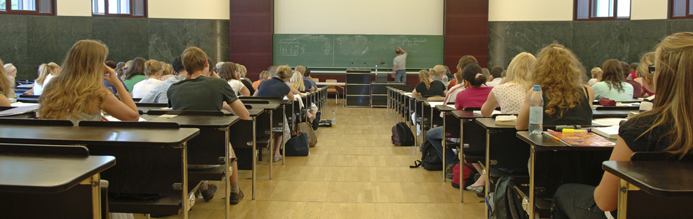
House Bill 5:
Provisions that Call for Engaged Families

Slide 16


New Texas High School Graduation Requirements
Graduation Toolkit
Herramientas para graduarse

Slide 17
Provision 1: Endorsements with Options Selected Initially by Eighth Graders with Parental Consent
Endorsements
STEM (Science, Technology, Engineering, and Mathematics)
Business and Industry
Public Services
Arts and Humanities
Multidisciplinary Studies
Notes:
Notes:
HB 5 requires that the endorsement will be placed on the diploma and transcript.
SBOE can choose to include specific course requirements in each of the endorsement areas but we do not know yet if they will do this. They have the authority to do so.
HB 5 requires that students must have multiple options for earning each endorsement, including, to the greatest extent possible, coherent sequences of courses. Additionally, the statute requires that student must be permitted to enroll in courses under more than one endorsement curriculum before the student’s junior year.
STEM – least complicated endorsement in statute. TEA has talked with SBOE about possible CTE courses for this area.
Business and Industry – aligns a lot to the current career clusters in CTE. TEA has visited with SBOE about possibly aligning these to the current coherent sequences in clusters.
Public Services – Per TEA’s conversation with SBOE, Culinary Arts & Hospitality may be moved from this endorsement to the Business and Industry endorsement.
Arts and Humanities – Per TEA’s conversation with SBOE, Political Science may be moving to Public Services – as that is more closely aligned with where courses reside within current course clusters.

Slide 18
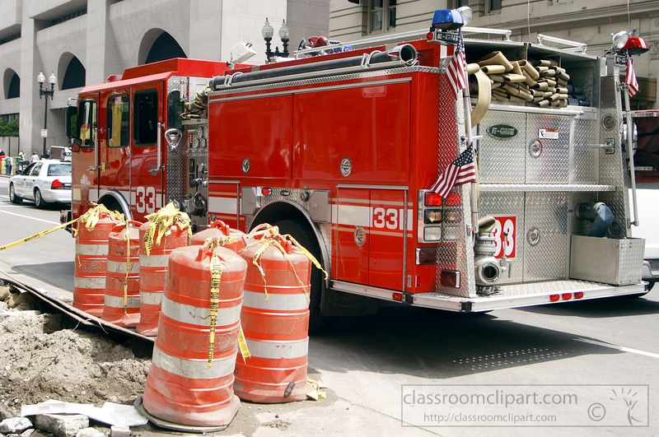
Provision 2: Options may include Locally Developed CTE Courses/Activities
Districts may offer courses or other activities, including apprenticeships, needed for industry-recognized credentials or certificates
Notes:
Section 8, 28.002(g-1); LBB p. 54
Conditions required:
The district develops a program under which the district partners with a public or private institution of higher education and local business, labor, and community leaders to develop and provide the course; and
The course or other activity allows the student to enter:
A CTE training program in the district’s region of the state;
An IHE without remediation;
An apprenticeship training program; or
An internship required as part of the accreditation toward an industry-recognized credential or certificate for course credit.
28.002 (g-2) Reporting
District must annually report to TEA names of the courses, programs, IHE, and internships in which the students have enrolled under (g-1) and TEA must make this information available to other districts

Slide 19
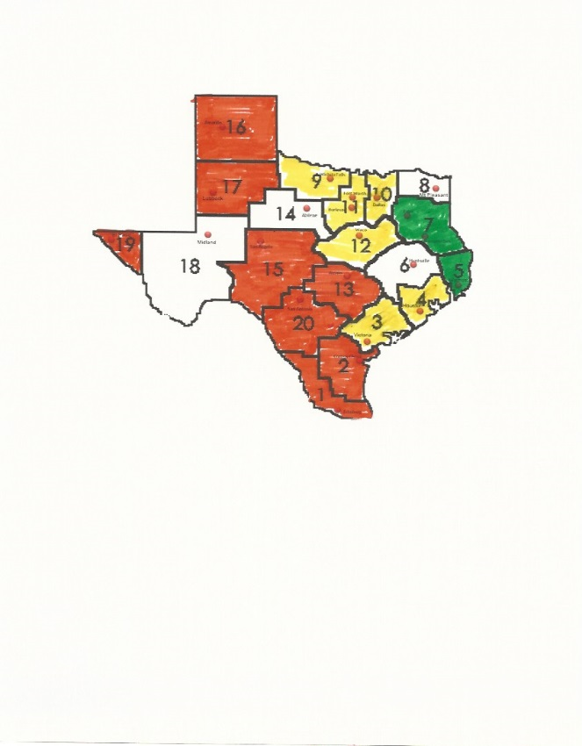
Provision 3: College Preparatory Courses (CPCs)
Districts must partner with at least one IHE to develop college prep courses in math and ELA for 12th grade students who do not meet college readiness standards or whose performance indicates they are not ready for entry-level college coursework.
Notes:
HB 5, Section 10 (TEC 28.014); LBB p. 115
Notes:
This is specific to mathematics and ELA courses.
Not meeting college readiness standards is automatically indicated if the student fails an EOC exam.

Slide 20
Provision 4: TEC 39.0545
To evaluate community and student engagement
Districts and campuses can showcase points of excellence and where opportunities for improvement
To tell the story of what is happening in districts and on campuses when it’s not a test day
An opportunity to highlight community values, which may be varied
  Reference: TATA (2015). TASA House Bill 5 Community Engagement Background Overview and Requirements of the New Statute. Located at http://www.tasanet.org/domain/175

Slide 21
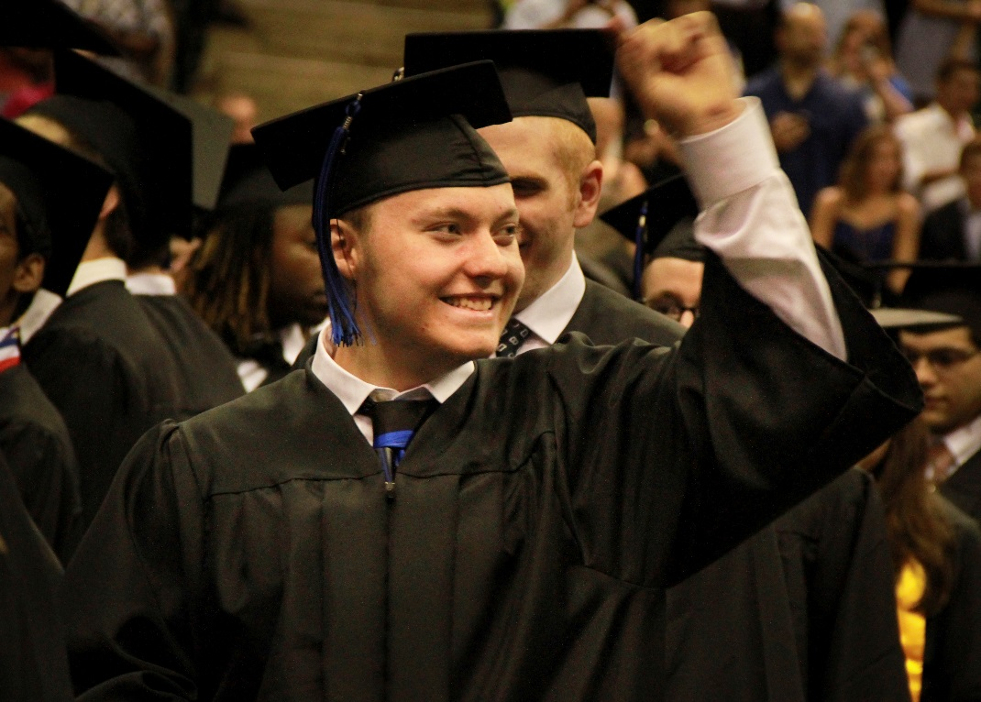
How are districts addressing state’s focus on family engagement?
http://www.nisdtx.org/Domain/6002

Slide 22
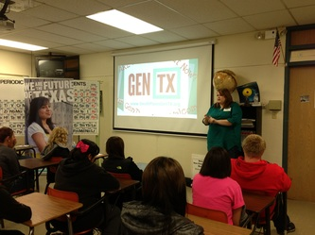
Statewide Focus on Family Support through Generation Texas (GenTX)
Texas has great resource to support engagement of families of students of all ages!
http://untavatar.org

Slide 23

Status of Family Engagement within Teacher Education

Slide 24
2004
Most teacher credentialing institutions incorporated only selected activities and did not appear to include the range of promising practices in parent involvement that are required within schools and classrooms.
Diane Hiatt-Michael, 2004
Preparing Teachers for Parental Involvement: Current Practices and Possibilities Across the Nation

Slide 25
2005
New teachers consider engaging and working with parents as their greatest challenge and the area they were least prepared to manage during their first year.
2004-2005 Metlife Survey of the American Teacher. Cited by Family Involvement Network of Educators (FINE), (2015). Is teacher preparation key to improving teacher practices with families? Harvard Family Research Center. Available at http://www.hfrp.org

Slide 26
2006
Leaders from about two thirds of Schools, Colleges, and Departments of Education agreed that “school, family, and community partnerships should be more prominent” in their curricula… Over 60% reported that they needed to prepare future teachers and administrators to plan and implement full programs of partnership.
Epstein, J. L., & Sanders, M. (2006). Prospects for change: Preparing educators for school, family, and community partnerships. Peabody Journal of Education, 81 (2), 81-120.

Slide 27
2011
Teacher education programs continue to face serious challenges in incorporating family engagement into the curriculum… This is unfortunate as a 2009 report found that teachers view lack of support from parents as their most pressing challenge and identify family engagement as one of the top strategies to improve outcomes for their students.
Caspe, M, Lopez, M. E., Chu, A., & Weiss, H. B. (2011). Teaching the teachers: Preparing teachers to engage families for student achievement. National PTA Issue Brief. Refers to Johnson, J., Yarrow, A, Rochkind, J., & Ott, A. (2009). Teaching for a living: How teachers see the profession today. Naperville, IL and Washington DC; Learning Point Associates and Public Agenda.

Slide 28
2013
Although parent involvement is addressed in most teacher education programs in Texas, coverage is insufficient among both ACP and university providers. … There were not significant differences between types of provider in extent of coverage, but there were qualitative differences in the models or approaches to parent involvement employed.
Jacobson, A. L., Harris, M. M., & Nathans, L. Parent and Family Involvement: Are Teacher Candidates in Texas Prepared? TAFCS Research Journal, January, 2013.

Slide 29
Actions to Prepare Teachers to Engage Families NOW

Slide 30

Program Mission and Vision
Based on examination of websites of 116 teacher education programs, Brossard found few used family friendly language. No relationship was perceived between the language of the mission statement and family content in the curriculum..
Recommendation; Develop mission and vision statements that value family and community engagement, and build them into the educator preparation programs of every level and subject though goals and objectives, content, assignments, assessments, and evaluation in ways that foster the building of capacity for engagement by both educators and the families and communities of their students.
Brossard, C. A. (2000). Preparing teachers to work with families: A national survey of teacher
education programs. Equity and Excellence in Education, 33 (2), 41-49, doi 10.1080/1066568000330207

Slide 31

For Early Professional Experiences and Assignments Develop Curriculum that will:
Honor the many roles played by families of students: supporter, encourager, monitor, model of learning, advocate, decision-maker, and collaborator
Consider the potential every student learning experience has for the development of social capital that extends to family and community
Foster self-perception as a collaborator among educators who work with families and communities.

Slide 32
For Early Professional Experiences and Assignments Develop Curriculum that will:
Provide models of family and community engagement that are culturally appropriate, collaboratively planned and implemented, and oriented toward group learning.
Include within the curriculum state and national model programs such as Academic Parent Teacher Team Model, Parent-Teacher Home Visit Program, Parents as Teachers, Parent Peer Educator, Parent Mentor Program, Parent University, PTA Communitario, Guideposts for Success, Campaign for Grade-Level Reading, Ready to Achieve Mentoring Program (RAMP), Right Turn Career-Focused Youth Transition Initiative,

Slide 33
Extra-curricular and Service Learning
Enable candidates to become familiar with community support organizations as they collaborate with family and community members more than as agencies to which teachers can refer families.
Provide service through EPP-sponsored professional organizations in ways that engage candidates in collaboration with families and community agencies rather than as donors of money or goods.
Include family and community members, as well as teachers and administrators, as speakers at meetings and events.

Slide 34
Select Partner Schools that:
Involve family and community members in planning and carrying out school programs that advance common learning goals
Successfully engage all sectors of the school community as partners in learning
Honor the full range of roles for families members
Practice dual capacity building
Show respect for family and community members in word and action
Recognize the importance of including preservice educators in all aspects of engaging families

Slide 35
Early Field Experiences
Make family and community engagement an expected and evaluated part of each early field experience in every program.
Cultivate candidate valuing of collaboration with families and the community and the Dual Capacity Building Framework
Cultivate recognition that engagement is a process, not a program
Offer candidates exposure to new ways of communicating with families, conducting tradition outreach events, and engaging family and community members with schools.
Expose candidates to family and community engagement units of school districts and their websites.

Slide 36
Clinical Experiences
Make family and community engagement an expected and evaluated part of clinical experiences in every program.
Assess teacher candidate valuing of and ability to collaborate with families and the community
Assess teacher candidate recognition of and practice that supports family engagement as a process, not a program.
Assure that candidates participate and have a chance to reflect on their clinical experiences in communicating with families, assisting with outreach programs, and engaging family and community members with the school in light of the Dual Capacity Building Framework.

Slide 37
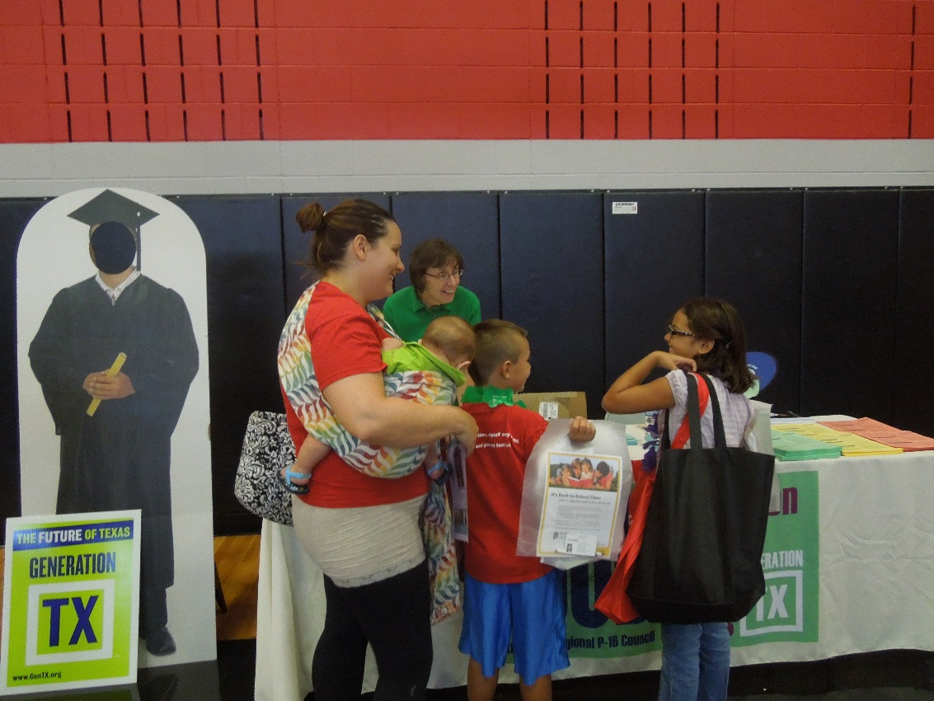
Roles for Teacher Candidates: Back to School Fair, United Way of Denton County

Slide 38
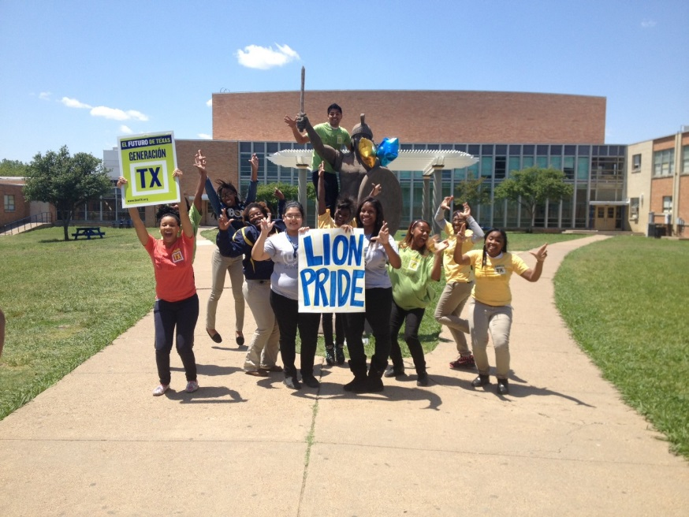
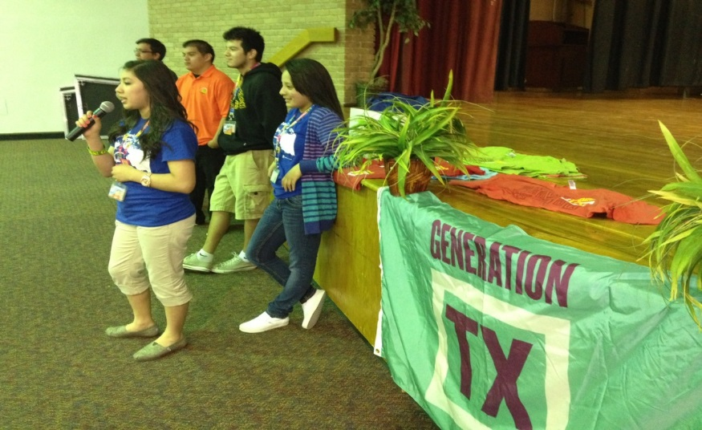
Roles for Teacher Candidates: Supporting college and career readiness

Slide 39
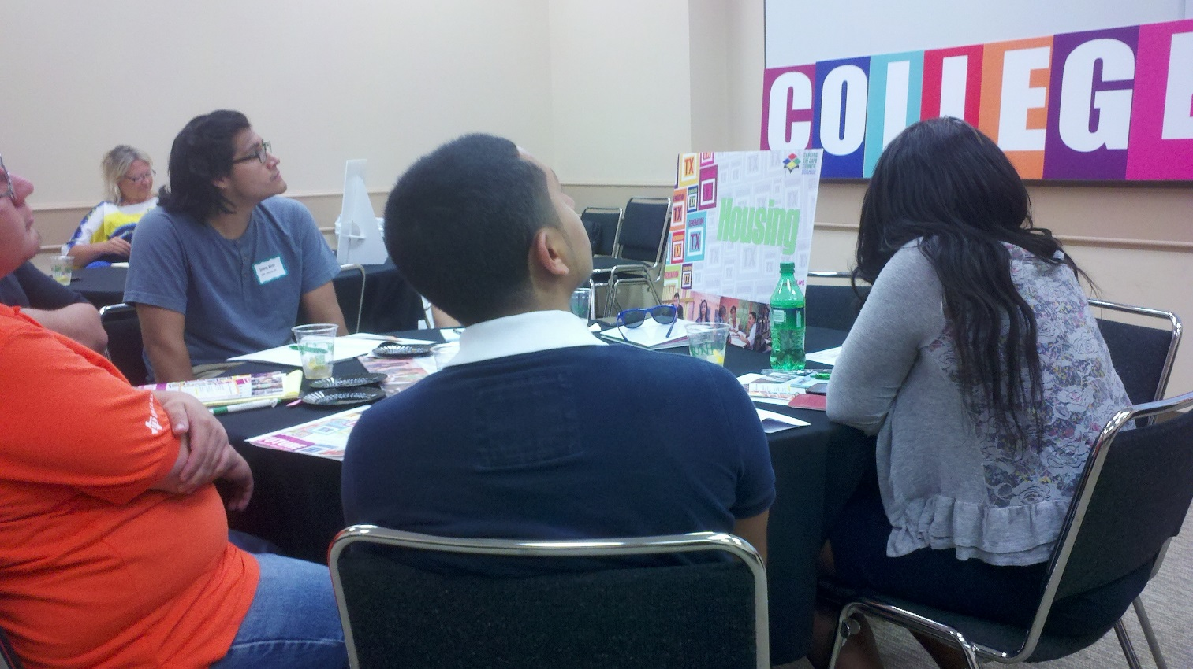
Roles for Teacher Candidate: G-Force and Advise Texas

Slide 40

How do you/could you engage teacher candidates with families and communities? Which practices have potential for dual capacity building?

Slide 41
Looking for resources?
Check out http://ntrp16.org/gentx

Slide 42
Presenters
Mary M. Harris
M. Jean Keller
Regent Professor Emerita
Co-director, AVATAR
University of North Texas
Denton, TX
Mary_harris@unt.edu
940 367-3026
Professor, Education
Director, AVATAR
University of North Texas
Denton, TX
Jean_keller@unt.edu
940 565-3427

