Slide 1




Effective Transition Counseling: Advising Students Who Create College Transcripts in High School
RGV LEAD Regional Conference 2015

Slide 2
Panelists
Texas State Technical College
  Norma Salazar, M.S., Director of Student Success
  Vanessa Maldonado, M.ED., Coordinator of Advisement Center
The University of Texas-Rio Grande Valley
  Sonia del Angel, Director, Educational Talent Search/Moderator
  Shirley Mills, PhD, Director of College Readiness Initiatives
South Texas College
  Sofia Peña, Director of Early College High Schools
Texas Southmost College
  Cherie Gallardo, Coordinator of Advising

Slide 3
This session continues a dialogue begun during transition-counseling conferences in 2012 and 2013. Today we will…
Provide an overview of the types of courses through which students can earn college credits in high school.
Share strategies for effective advising of students who create college transcripts in high school through dual and concurrent enrollment and how poor academic performance impacts their college academic standing (see handout on Post-Secondary Information on Scholastic-Academic Standing).
Share strategies designed to help high school students establish graduation plans focused on students’ long-term college-and-career goals.

Slide 4
Effective Advisement
….begins with the Introduction of Endorsements at the time a career assessment is administered in the eighth grade.
Endorsements help students understand how they can get a head start on a college or university major by combining various types of college level courses in high school (AP credit, articulated credit [ATC, or Advanced Technical Credit], dual credit, and/or concurrent credit.)
Advisement that focuses on programs and majors, not courses and credits, helps students to select Endorsements leading to certificates or degrees, providing a genuine “head start,” rather than taking courses that lead to nowhere.
Advisement on preparing for the TSI exams. The TSI is a series of 3 lengthy exams that can overwhelm any student. When, and if possible, students should take one or two tests at a time, rather than all 3 at once to increase the likelihood of success.
Regardless of Endorsement selected, students and families need to understand that concurrent and dual-credit courses taken in high school result in permanent college transcripts and financial aid records.

Slide 5
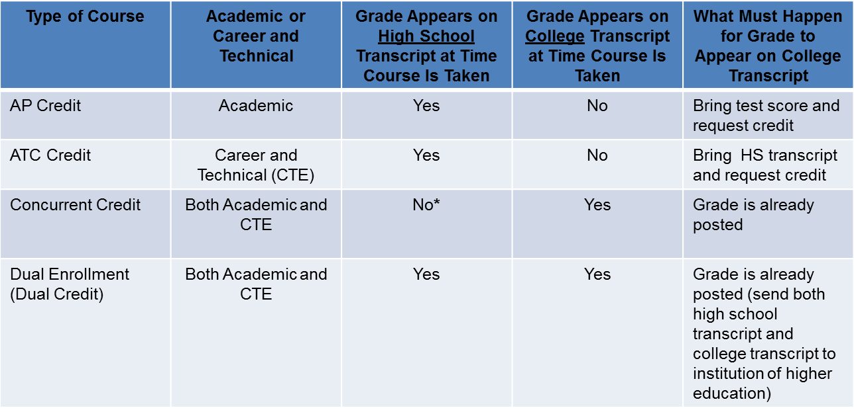
Types of College Courses through which students can earn college credits in high school
Types of courses through which students can earn college credit:
*Depends on district policy—student should check with high school counselor.

Slide 6
Effective Advisement:
How do college courses differ?
Students, parents, and relevant school district personnel need to know that Dual and Concurrent Enrollment grades reflect on permanent college transcripts, compared with AP and ATC, which post when credit is requested at the college or university.
  Professional school requirements (engineering, pharmacy, medical, etc.), may mandate that Dual Credit courses be repeated in professional school.
Students, parents, and relevant school district personnel should familiarize themselves with college/university scholastic and financial aid policies and procedures (Six-Drop Rule, “No Show,” suspension policies, drop deadlines, SAP, etc.—different for each institution). See handout on Post-Secondary Information on Scholastic-Academic Standing.

Slide 7
Scholastic/Academic Standing
Definition: Scholastic/Academic Standing is a measure of student academic achievement in relation to student certificate/degree requirements.
  Determines whether student is eligible to be accepted into a program (e.g. Nursing, Engineering, etc.) or a college/university.
  Determines whether student will be eligible to continue taking college courses while still in high school and whether student will graduate from college, in cases where student is attending college after high school graduation.
Scholastic/Academic Standing is different from Financial Aid Standing (Satisfactory Academic Progress)
Policies vary from institution to institution.

Slide 8
Academic Impact of Enrolling in College Courses
Important for students, parents and relevant personnel to know:
  -Scholastic Standing* Policies such as Good Standing,
  Scholastic Probation, & Scholastic/Suspension.
  -Grades/GPA in all college courses directly impact Scholastic Standing.
  -How Dual Credit/Concurrent Enrollment Courses can impact the student’s
  college scholastic standing. For example: A high school student can be placed
  on scholastic suspension at the college level, which can prevent him or her
  from progressing through his/her major. Student may also end up starting
  his/her first year in college (full-time) on academic suspension.
  *The terms “Scholastic Standing” and “Academic Standing” may be used interchangeably.

Slide 9
Scholastic Standing
For example, the following reflects three possible “standings” at a local college.*
• Good Standing - student maintains at least a 2.00 Standard of
Progress Cumulative GPA and Term GPA.
• Scholastic Probation - student whose Standard of Progress
Cumulative GPA or Term GPA falls below 2.00.
• Scholastic Suspension - occurs when a student on Scholastic
Probation has a term and/or a Cumulative GPA below 2.00.
*The penalties for Scholastic/Academic Probation and Suspension also
vary by college or university.
*Scholastic/Academic Standing is different from Financial Aid
Standing (Satisfactory Academic Progress).

Slide 10
Scholastic Standing
CAUTION: Remember that these policies also apply to students who create college transcripts in high school.
A student may graduate from high school, but if student had poor/failing grades in Dual/Concurrent Credit courses …
  -That student may be on scholastic/academic suspension at the college level
  upon high school graduation. This may impact their financial aid eligibility.
  -The student may be required to appeal his/her suspension if he/she decides
  to enroll in college/university after high school graduation.
  -Academic suspension and financial aid suspension are two different things.
  In most cases, students on academic suspension are also on financial aid
  suspension, BUT THIS MAY NOT ALWAYS BE THE CASE. Students should
  contact the Financial Aid Office for more information.
  -Policies vary from institution to institution. Refer to college/university
  websites for more information.

Slide 11
Establish Plans focused on students’
long-term college-and-career goals.
Students, parents, and relevant school district personnel should…
  Be familiar with college/university admissions requirements
  Be familiar with the college/university’s testing requirements
  Be familiar with college/university scholastic policies and financial aid policies
  Know that for Concurrent Enrollment or Dual Credit courses, both the high school transcript and the college transcript(s) should be sent to the college/university admissions office when applying.
  Check whether courses taken in high school (ATC, AP, Concurrent, and Dual Credit) will count toward their degree plans at the college/university

Slide 12
Establish Plans focused on students’
long-term college-and-career goals.
  Find out at the Admissions Offices whether credits earned at a community/technical college will transfer to the university of preference.
  For courses that will transfer, it is also important to find out how the course will transfer (as an elective or as part of major).
  Find out when a program cohort begins (Ex. a Nursing Program may begin in the fall so students who don’t meet all the program criteria may have to wait till the next fall semester to start the program).
  EVERY STUDENT HAS UNIQUE NEEDS AND CAREER GOALS!

Slide 13
Other Recommendations for Student Success
Professional Development for relevant personnel on
College Readiness/Effective Career Counseling.
Invest in Resources that will assist in providing
effective advisement to students.
Have the right team in place for college advisement.

Slide 14
HB5 & ELA Math College Prep Courses
Waiver for high school seniors who failed TSI
ELA and Math high school courses that take the
place of the TSI
TSI is used as a measure of college readiness
Students can use waiver to enter university
Allows them to take credit-bearing courses in Math
and English their first year

Slide 15
Graduation Tool Kit
· tea.texas.gov/communications/grad_toolkit/booklet.pdf
(Spanish/English available)

Slide 16

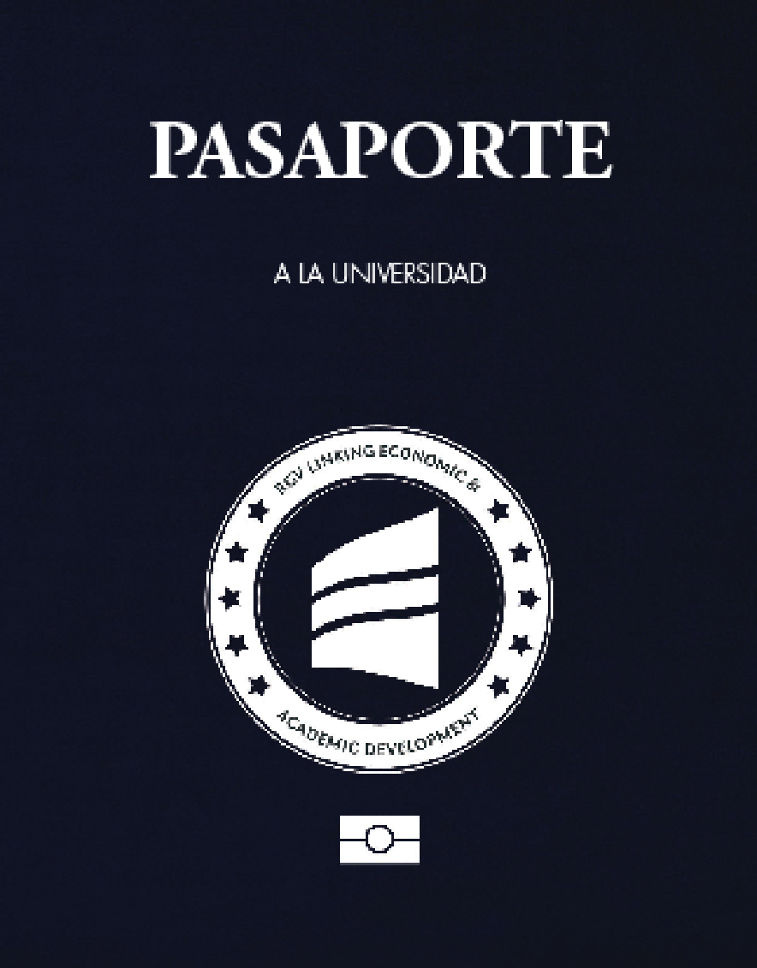
Resources
(Passports are available at www.rgvlead.com/downloads.shtml)

Slide 17
Resources
A wealth of information can be found at the college or university website. The college or university Student Handbook also contains information on these policies. Both sites are included here for each institution.
STC
www.southtexascollege.edu/
www.southtexascollege.edu/pdf/Student_Handbook.pdf
TSC
www.tsc.edu/
www.tsc.edu/student_handbook/2015-2016/
TSTC
www.tstc.edu/student_life/catalog
www.tstc.edu/campuses/harlingen
UTRGV
www.utrgv.edu/en-us/
www.utrgv.edu/_files/documents/student-experience/student-rights-responsibilities/srr-hop-stu-02-100.pdf

Slide 18
Thank You!

