Slide 1
Addressing 60x30TX: AVATAR’s Use of Local Data to Sustain Vertical Alignment
NTCCC 5th Annual Spring Leadership Conference 2016

Slide 2
Goals for Participants
1. Know 60x30TX goals and how they connect to AVATAR
2. Experience how AVATAR partnerships use data to assess college readiness, progress, and performance of local students
3. Assess adequacy of available data for use in local accountability dialogues for 60x30TX
http://untavatar.org

Slide 3
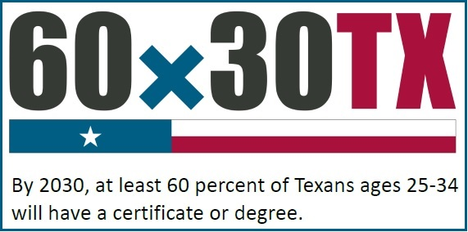
What is 60x30TX higher education strategic plan?
Name (include yourself) | District/University/Workforce or P-16 Council | Title/Position |  | Phone
LaShonda Evans | Region 4 ESC | Education Specialist | lashonda.evans@esc4.net | 713-744-6380
June Giddings | GCPASS/Houston A+ Challenge | Director | jgiddings@houstonaplus.org | 713-658-1881
Cynthia Williams | Spring ISD | CTE Director | cynthiaw@springisd.org | 281-891-6200
Tiffany Rhodriquez | Spring ISD | Guidance & Counseling Director | trhodri@springisd.org | 281-891-6368
Beth Gilleland | Klein ISD | Student Support Services Officer | egilleland@kleinisd.net | 832-249-4319
Michelle McCharen | Klein ISD | College & Career Readiness Counselor | mmcharen@kleinisd.net | 281-467-3192
Brian Reeves | Lone Star University Park | English Department Chair | Brian.L.Reeves@lonestar.edu | 281-290-3749
Martha Donnelly | Lone Star University Park | Math Department Chair | Martha.E.Donnelly@lonestar.edu | 281-290-5053

Slide 4
Overarching goals
By 2030, at least 60 percent of Texans ages 25-34 will have a certificate or degree.
In that year, at least 550,000 students will complete a certificate, associates, bachelor’s or master’s degree from an institution of higher education in Texas.
By 2030, all graduates from Texas public institutions of higher education will have completed degrees with identified marketable skills.
By 2030, undergraduate student loan debt will not exceed 60 percent of first-year wages for graduates of Texas public institutions.
http://untavatar.org

Slide 5
Principles for implementation
Maintaining excellence in higher education while focused on workforce skills and knowledge
Demographic targets to match changing ethnography of the state
Centered on students
Latitude for two and four year institutions with room for local creativity
http://untavatar.org

Slide 6

What is AVATAR ?
Name (include yourself) | District/University/Workforce or P-16 Council | Title/Position |  | Phone
LaShonda Evans | Region 4 ESC | Education Specialist | lashonda.evans@esc4.net | 713-744-6380
June Giddings | GCPASS/Houston A+ Challenge | Director | jgiddings@houstonaplus.org | 713-658-1881
Cynthia Williams | Spring ISD | CTE Director | cynthiaw@springisd.org | 281-891-6200
Tiffany Rhodriquez | Spring ISD | Guidance & Counseling Director | trhodri@springisd.org | 281-891-6368
Beth Gilleland | Klein ISD | Student Support Services Officer | egilleland@kleinisd.net | 832-249-4319
Michelle McCharen | Klein ISD | College & Career Readiness Counselor | mmcharen@kleinisd.net | 281-467-3192
Brian Reeves | Lone Star University Park | English Department Chair | Brian.L.Reeves@lonestar.edu | 281-290-3749
Martha Donnelly | Lone Star University Park | Math Department Chair | Martha.E.Donnelly@lonestar.edu | 281-290-5053

Slide 7
Fun Facts: AVATAR
Academic Vertical Alignment Training and Renewal
First funded in 2011 by the Texas Higher Education Coordinating Board as part of its Closing the Gaps strategic plan
Facilitated by the University of North Texas for the North Texas Regional P-16 Council, which serves the Dallas Fort Worth and Metroplex areas
Active in 2015 in all 20 Education Service Center regions of the Texas Education Agency
http://untavatar.org

Slide 8
Changing Focus of AVATAR
Close gaps in student access to and success in post-secondary education through collaboration focused on
2011-14: Vertical alignment of the core curriculum
2014-15: Vertical alignment through College Preparatory Courses in ELA and mathematics designed for high school students who are not college ready and may, according to local agreement, exempt the TSI (a provision of HB 5, 2013)
2015-16: Vertical alignment of curriculum arising from endorsement options offered by local high schools and continuation of work begun in earlier years (a provision of HB 5, 2013)
http://untavatar.org

Slide 9
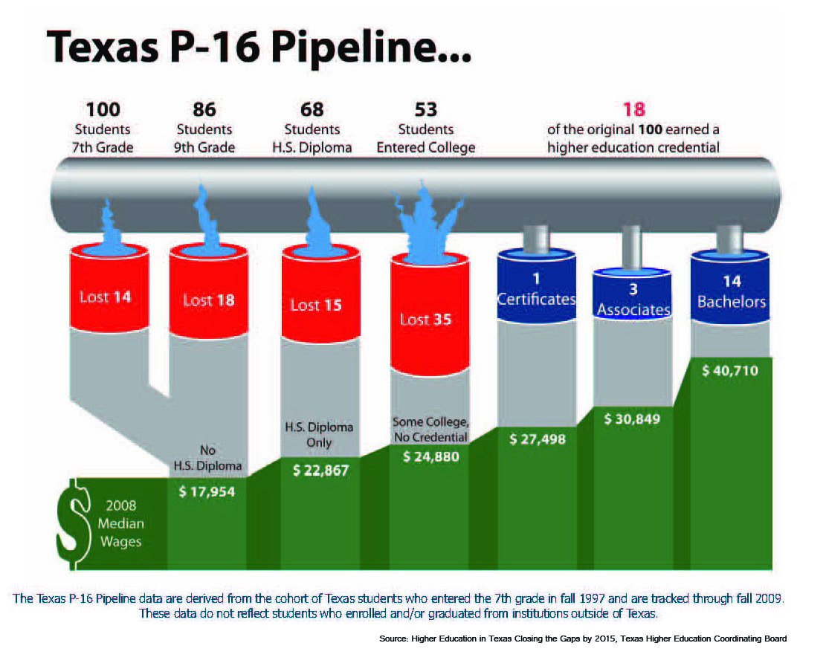

Slide 10
Vertical Alignment Research
  Squires (2009) reviewed research and concluded:
  Alignment improves student outcomes.
  Alignment is a powerful tool for assuring the written, taught, and tested curriculum are the focus of instruction, assessment, and professional development.
  Smith (2014) focused on Algebra 1 and concluded:
    Alignment of high school instruction around frameworks and vertical progressions enhances student success and is facilitated by collaborative planning and professional development.
  References: Squires, D. A. (2009). Curriculum Alignment: Research-Based Strategies for Increasing Student Achievement. Thousand Oaks, CA, Corwin,
  Smith, T.M. (2014). Curricular Alignment to Support Student Success in Algebra. American Institute for Research. Retrieved from https://www2.ed.gov/programs/dropout/curricularalignment092414.pdf

Slide 11
High Schools
2 Year IHEs
Scaffolding
Student
Success
4 Year IHEs
Regional ESCs
Regional P-16
Councils
AVATAR is a Partnership of Regional Leaders from these institutions

Slide 12
The AVATAR Process
Creates and builds relationships through ongoing critical conversations
Uses regional data to make alignment decisions
Develops shared understanding of college and career readiness and success for students
Identifies and implements intentional actions
Evaluates, sustains, and shares vertical alignment work
http://untavatar.org

Slide 13

How does an AVATAR partnership use local data?

Slide 14

What is your evidence?
The Texas Education Agency (TEA) and Texas Higher Education Coordinating Board (THECB) collect many useful indicators and make them available to the public.

Slide 15
The goal of this module is for your partnership to gain a holistic view of local students’ college readiness by viewing and discussing data.
Leaders, please note. This module requires local data obtained by following the directions on the ”Local Data PowerPoint Instructions, 2015 update.”

Slide 16
This Module will introduce…
    Indicators of
    How ready local high school students are for college
    College pathways followed by local students
    Performance of local students in college

Slide 17


What is the demography of the students at North Garland High School?
http://untavatar.org

Slide 18
Student Demographics:
North Garland High School,
2013-14
Student Demographic | Number Students
TOTAL | 2324
Grade 9 | 701
Grade 10 | 591
Grade 11 | 513
Grade 12 | 519
Graduating class 2013 | 492
Minimum curriculum | 7.7%*
Recommended curriculum | 92.3%*
  Student Body:
*State Comparison:
Minimum 18.4%
Recommended 81.6%

Slide 19
Student Ethnicity:
North Garland High School,
2013-14
Ethnic Group | Percentage
African American | 15.3
Hispanic | 54.5
White | 10.5
American Indian | 0.4
Asian | 17.4
Pacific Islander | 0
2 or more races | 1.8

Slide 20
Student Subgroups:
North Garland High School,
2013-14
Demographic groups | Percentage
Economically disadvantaged | 62.9
English Language Learners (ELL) | 6.6
With disciplinary placements | 1.7
At risk* | 51.9
Mobility (2012-13) | 9.3
*At risk of dropping out of school based on the performance and status indicators listed in the TAPR Glossary.
  Other Descriptors of Student Body in Percentages:

Slide 21

    How ready are North Garland High School students for college?
http://untavatar.org

Slide 22
Percent College Ready High School Graduates, 2013-2014, Based on Test Results
North Garland High School Class of 2013 N=492 | All | African American | Hispanic | White
ELA | 62 | 65 | 53 | 65
Mathematics | 76 | 70 | 69 | 83
Both subjects | 55 | 59 | 41 | 66
  Other Descriptors of Student Body in Percentages:

Slide 23
Percent Advanced Course Dual Credit Completion in 2013-14
  Other Descriptors of Student Body in Percentages:
North Garland High School Students, 2013-2014 | All | African American | Hispanic | White
2013 | 37.6 | 35.5 | 30.8 | 42.6
2012 | 38.1 | 35.1 | 31.8 | 30.1

Slide 24
Percent AP/IB Enrollees Tested and Meeting Criteria in 2013-14
  Other Descriptors of Student Body in Percentages:
North Garland High School Students | All | African American | Hispanic | White
Tested | 27.0 | 26.0 | 17.3 | 26.6
Met Criteria | 52.9 | 48.7 | 48.4 | 75.9

Slide 25
Percent 2013 Graduates Enrolled in IHE and Completing One Year without Remediation
  Other Descriptors of Student Body in Percentages:
North Garland High School Graduates Class of 2012 | All | African American | Hispanic | White
Enrolled | 64.9 | na | na | na
Completed One Year no Remediation | 77.5 | na | na | na

Slide 26


    Where do North Garland High School students go to college?
http://untavatar.org

Slide 27
Texas Public Institutions of Enrollment of North Garland High School 2013 Graduates
Institution of Enrollment, Fall, 2013 | N= 490
Richland College | 144
University of Texas at Dallas | 25
University of North Texas | 14
Texas State University | 10
Texas Tech University | 9
University of Texas at Arlington | 9
El Centro College | 8
Other 4-year public institution (16) | 40
Other 2-year public institution (8) | 25
  Other Descriptors of Student Body in Percentages:

Slide 28
6-year College Degree Attainment by North Garland High School 2005 Graduates
Institution of Enrollment | BA/BS | AA | Cert
Richland College |  | 45 | 1
University of North Texas | 64
University of Texas at Dallas | 61
University of Texas at Austin | 38
University of Texas at Arlington | 24
University A&M University | 20
Texas Woman’s University | 16
Southern Methodist University | 13
Texas Tech University | 12
  Other Descriptors of Student Body in Percentages:

Slide 29
Grade Point Average of 2012 North Garland HS Graduates for First Year in Texas College
  Other Descriptors of Student Body in Percentages:
Type of IHE | N | <2.0 | 2.0-2.49 | 2.5-2.99 | 3.0- 3.49 | >3.5 | Unknown
2-year public | 171 | 56 | 19 | 19 | 34 | 28 | 15
4-year public | 110 | 26 | 13 | 26 | 24 | 19 | 2

Slide 30

    What are the demographic and success profiles of Richland College and University of North Texas students?
http://untavatar.org

Slide 31
Student Demographics: Richland College and University of North Texas, Fall 2014
Demographics or Degrees Awarded | Richland College | UNT
TOTAL | 16,151 | 36,164
White | 26.7% | 52%
Hispanic | 27.0% | 19.5%
African American | 18.6% | 13.8%
Asian-Pacific Is | 11.7% | 5.6%
Other/International | 10.6% | 3.7%
Associates | 1,717 | na
Certificates | 341 first | na
Baccalaureate | na | 6158
Masters | na | 1603
Doctoral | na | 284

Slide 32
Participation in Dual Credit Enrollment, Fall 2014
Institution | Number Dual Credit Students | Student Credit Hours
Richland College | 1,878 | 15,050
UNT | 0 | 0
  Other Descriptors of Student Body in Percentages:

Slide 33
First Time In College (FTIC)Student Entry Profiles, Fall 2013 Cohort
Demographic | Richland College | UNT
First Time in College (FTIC)Students | 1868 | 4,276
Met entry standard, all three academic areas | 816 | 3,984
Did not meet, math | 653 | 102
Did not meet, reading | 639 | 120
Did not meet, writing | 751 | 151
  Student Body:

Slide 34
FTIC Student Remediation and Success Rates, Fall 2013 Cohort Tracked for One Year (N=1868)
Richland College | Percent Enrolled in Remediation | Percent Met TSI or Passed College Course | Percent Returned in Fall 2014
Met entry standard, math | 16.9 | na | 66.6
Met entry standard, reading | 0.9 | na | 63.3
Met entry standard, writing | 7.5 | na | 64.3
Did not meet, math | 50.8 | 11.9 | 47.2
Did not meet, reading | 87.6 | 50.4 | 52.7
Did not meet, writing | 83.2 | 46.1 | 53
  Student Body:

Slide 35
FTIC Student Remediation and Success Rates, Fall 2013 Cohort Tracked for One Year (N=4276)
UNT | Percent Enrolled in Remediation | Percent Met TSI or Passed College Course | Percent Returned in Fall 2014
Met entry standard, math | 0.2 | na | 86.8
Met entry standard, reading | 0 | na | 86.8
Met entry standard, writing | 0 | na | 87
Did not meet, math | 94.1 | 70.6 | 83.3
Did not meet, reading | 0 | 89.2 | 81.7
Did not meet, writing | 0.7 | 76.2 | 77.5
  Student Body:

Slide 36

    What about performance of students who transfer?
http://untavatar.org

Slide 37
Richland College Students: Where Did They Transfer from Fall 2013 to 2014?
Status of Academic Program Students | Percent Still here | Percent at other 2-year | Percentat 4-year*
Richland Graduates | 17.9 | 4.7 | 41.5
Non-graduates | 39.6 | 7.4 | 10.3
Core completers | 27.5 | 9.6 | 30.8
  Other Descriptors of Student Body in Percentages:
*Most likely institutions of transfer:
University of Texas at Dallas (315, F 2013)
University of North Texas (128)
University of Texas at Arlington (103)
Texas A&M Commerce (41)
Texas Woman’s University (36)

Slide 38
First Year Grade Point Average of Richland College Transfers to UNT,
Fall 2013
Student Characteristics | N | <2.0 | 2.0-2.49 | 2.5-2.99 | 3.0- 3.49 | >3.5 | Unknown
Took Developmental Education | 79 | 32 | 15 | 11 | 17 | 12 | 1
No DE | 49 | 16 | 9 | 4 | 12 | 7 | 1
Core complete | 49 | 10 | 9 | 4 | 14 | 12 | 0
  Other Descriptors of Student Body in Percentages:

Slide 39
Numbers are not enough! Can you answer these questions?
What endorsements are offered by your high school partner(s)?
What career pathways are available to students?
What is known about students who are eligible for College Preparatory Courses?
What career and technical programs are offered by your 2-year partner(s)?
What collaborations create pipelines between your 2-year and 4-year partners?

Slide 40

How adequate are AVATAR data, and what’s coming next?

Slide 41
Overarching goals
By 2030, at least 60 percent of Texans ages 25-34 will have a certificate or degree?
At least 550,000 students in the year 2030r will complete a certificate, associates, bachelor’s or master’s degree from an institution of higher education in Texas.
By 2030, all graduates from Texas public institutions of higher education will have completed degrees with identified marketable skills.
By 2030, undergraduate student loan debt will not exceed 60 percent of first-year wages for graduates of Texas public institutions.
http://untavatar.org

Slide 42
Expansion of institutional resumes
By 2030, all graduates from Texas public institutions of higher education will have completed degrees with identified marketable skills.
http://www.txhighereddata.org/Interactive/Resumes/marketable skills.
http://untavatar.org

Slide 43
Addition of CREWS
By 2030, undergraduate student loan debt will not exceed 60 percent of first-year wages for graduates of Texas public institutions.
CREWS=Consumer Resource for Education and Workforce Statistics
Edhttp://www.thecb.state.tx.us/apps/txcrews/
http://untavatar.org

Slide 44

How helpful are available and projected data for local use?
http://untavatar.org

Slide 45
Our Observations
Knowledge of state comparisons helps
Cohort data are outdated for users
Data confirm feeder patterns
Local data raise new questions
http://untavatar.org

Slide 46
Our Observations
State agencies are anticipating 60x30TX
Annual updates by agencies not coordinated
Coordination with CREWS adds complications
IHE’s are advantaged by defining new measures
http://untavatar.org

Slide 47
Presenters
Mary Harris, Professor Emerita, University of North Texas, Co-Convener, North Texas Regional P-16 Council, Denton, TX, mary.harris@unt.edu, 940 367-3026
Jean Keller, Professor, Kinesiology, Health Promotion, and Recreation, University of North Texas, Convener, North Texas Regional P-16 Council, Denton TX, jean.keller@unt.edu, 940 565-3427

